Slide 1
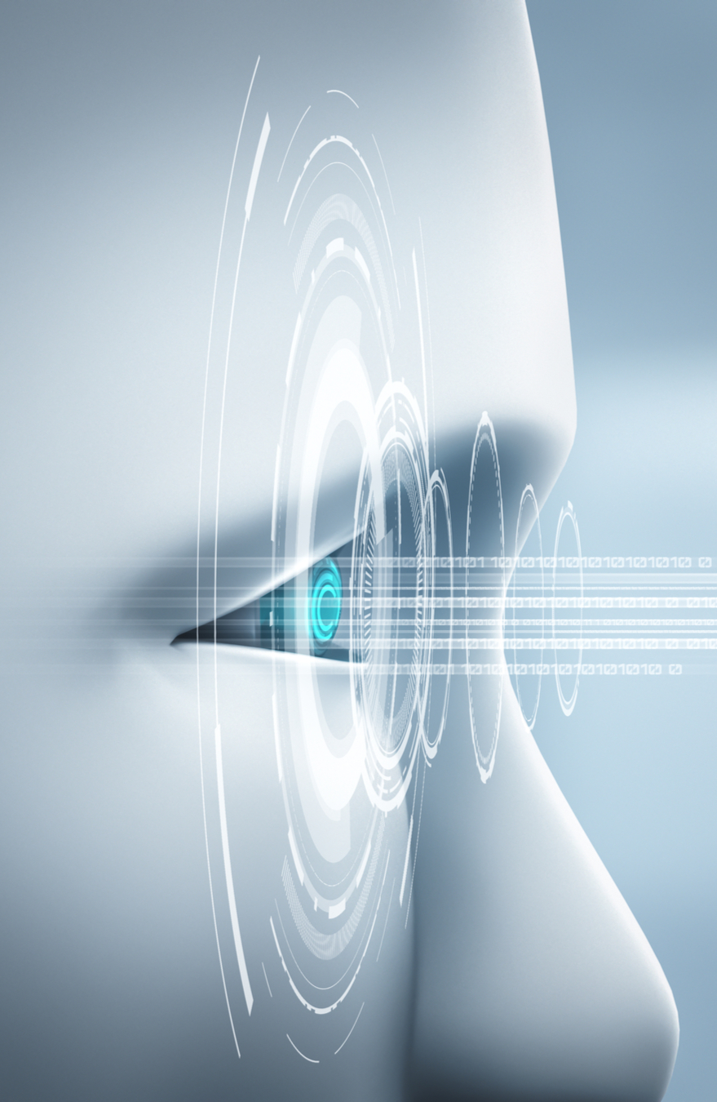
Computer Vision Applications
By Quadeer Shaikh

Slide 2

About me
Work Experience
Risk Analyst
Morgan Stanley (Jan 2023 – Present)
Data Science Intern
AkzoNobel Coatings International B.V. Netherlands (Feb 2022 – Dec 2022)
Data Science Intern
EzeRx Health Tech Pvt. Ltd. (Jan 2022 – July 2022)
Associate Engineer
Tata Communications Ltd. (July 2019 – Aug 2020)
Network Automation and Analysis Engineer Intern
Cisco (June 2018 – July 2018)
Education
M.Tech – Artificial Intelligence
NMIMS (2021 - 2023, currently pursuing)
B.E. – Computer Engineering
Mumbai University (2015 - 2019)

Slide 3
Advanced CNN Architectures
An intuition to build your own models and leverage the pretrained model

Slide 4

Google’s thoughts on building CNNs

Slide 5
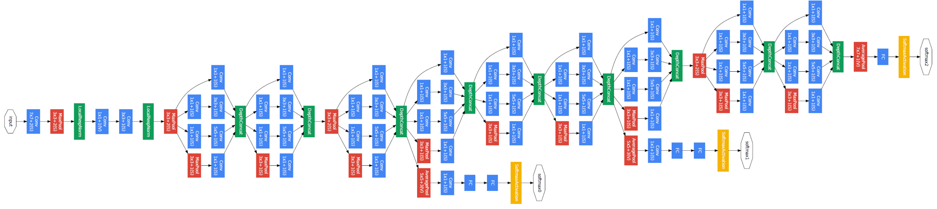
GoogleNet/Inception V1

Slide 6
Google’s Approach
GoogleNet/Inception V1 uses a network 22 layers deep (deeper than VGGNet) while reducing the number of parameters by 12 times (from ~138 million to ~13 million) and achieving significantly more accurate results.
The kernel size of the convolutional layer—We’ve seen in previous architectures that the kernel size varies: 1 × 1, 3 × 3, 5 × 5, and, in some cases, 11 × 11 (as in AlexNet). When designing the convolutional layer, we find ourselves trying to pick and tune the kernel size of each layer that fits our dataset. Recall from chapter 3 that smaller kernels capture finer details of the image, whereas bigger filters will leave out minute details.
When to use the pooling layer—AlexNet uses pooling layers every one or two convolutional layers to downsize spatial features. VGGNet applies pooling after every two, three, or four convolutional layers as the network gets deeper

Slide 7

Google’s Approach
Configuring the kernel size and positioning the pool layers are decisions that are made by trial and error and experiment
Google RnD Team’s idea - “Instead of choosing a desired filter size in a convolutional layer and deciding where to place the pooling layers, let’s apply all of them all together in one block and call it the inception module.”

Slide 8
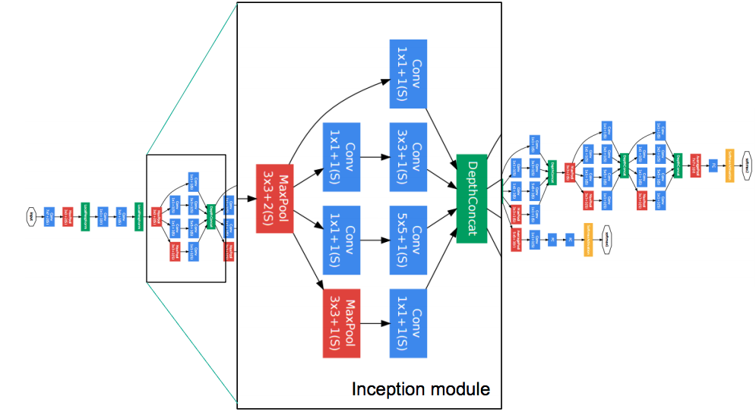
GoogleNet/Inception V1

Slide 9
Brainstorming of Inception Module
The naïve version of Inception module has a big computational cost problem due to the usage and processing of larger filters like 5x5
The input volume with dimensions of 32 × 32 × 200 will be fed to the 5 × 5 convolutional layer of 32 filters with dimensions = 5 × 5 × 32.
This means the total number of multiplications that the computer needs to compute is 32 × 32 × 200 multiplied by 5 × 5 × 32, which is more than 163 million operations. (32x32x200=204800, 5x5x32=800 -> 204800x800 = 163,840,000
While Google thought that this computation can be performed with modern computers this computation is still expensive.

Slide 10
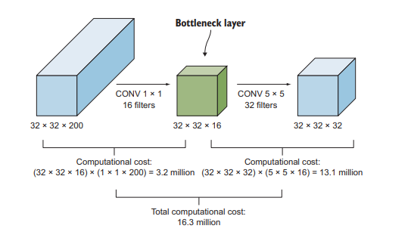
Dimensionality Reduction Layer (1x1 Conv Layer)
The 1 × 1 convolutional layer can reduce the operational cost of 163 million operations to about a tenth of that. That is why it is called a reduce layer/bottleneck layer.
The idea here is to add a 1 × 1 convolutional layer before the bigger kernels like the 3 × 3 and 5 × 5 convolutional layers, to reduce their depth, which in turn will reduce the number of operations.
Suppose we have a input feature map of 32x32x200 and we apply a 1x1x16 convolution. This reduces the dimension volume from 200 to 16 channels. We can now apply 5x5 convolution to this output.

Slide 11
Dimensionality Reduction Layer (1x1 Conv Layer)

Slide 12
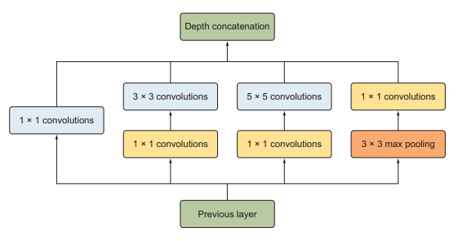
Inception Module with Dimensionality Reduction
Does shrinking the depth representation size so dramatically hurt the performance of neural network ?
Szegedy et al. ran experiments and found that as long as you implement the reduce layer in moderation, you can shrink the representation size significantly without hurting performance and save a lot of computations
Note: We will add a 1 × 1 convolutional reduce layer before the 3 × 3 and 5 × 5 convolutional layers to reduce their computational cost. We will also add a 1 × 1 convolutional layer after the 3 × 3 max-pooling layer because pooling layers don’t reduce the depth for their inputs

Slide 13
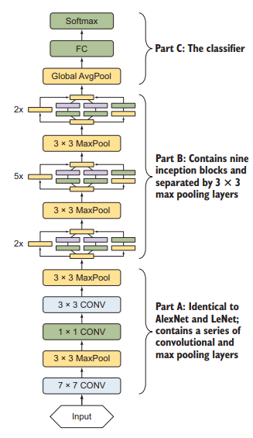
GoogleNet/Inception V1

Slide 14
GoogleNet/Inception V1
“Given the relatively large depth of the network, the ability to propagate gradients back through all the layers in an effective manner was a concern. One interesting insight is that the strong performance of relatively shallower networks on this task suggests that the features produced by the layers in the middle of the network should be very discriminative. By adding auxiliary classifiers connected to these intermediate layers, we would expect to encourage discrimination in the lower stages in the classifier, increase the gradient signal that gets propagated back, and provide additional regularization.”

Slide 15
GoogleNet/Inception V1 Summary
Following were the developments
Inception Block contains
1 × 1 convolutional layer
1 × 1 convolutional layer + 3 × 3 convolutional layer
1 × 1 convolutional layer + 5 × 5 convolutional layer
3 × 3 pooling layer + 1 × 1 convolutional layer
1x1 conv layers are used for depth dimensionality reduction thus reducing the floating point operations
Uses Global Average Pooling instead of Flatten
Uses Auxillary classifiers for prediction and gradient propagation at intermediate parts of the network

Slide 16
Microsoft’s thoughts on building CNNs
Google
Microsoft
Keep up

Slide 17
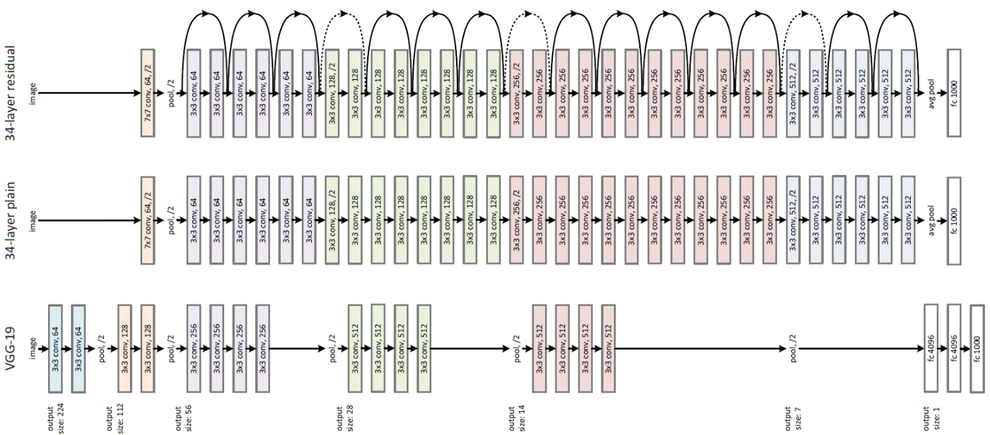
ResNet

Slide 18
Microsoft’s Approach
MS research team introduced a novel residual module architecture with skip connections
The network also features heavy batch normalization for the hidden layers
Upon observing AlexNet, VGGNet, Inception you must have noticed the deeper the network, the larger its learning capacity and the better it extracts features from the images.
This happens because deeper networks are able to represent very complex functions, which allows the network to learn features at many different levels of abstraction, from edges (at the lower layers) to very complex features (at the deeper layers).
VGG-19 was 19 layers, GoogleNet was 22 layers can we go deeper ?

Slide 19
Microsoft’s Approach
Downsides of Deeper Networks
Adding too many layers makes the network prone to overfit on the training data
However overfitting can be addressed using regularization, dropout and batch normalization
Now can we build networks which are 50/100/150 layers deep and good at learning features ?
Vanishing and Exploding Gradients
During backpropagation, in the chained multiplication the gradient from the later layers will become very small by the time it reaches the initial layers of the network – applicable to activation functions which are diminishing in nature like tanh and sigmoid
During backprop, it also might be the case that the gradient grows exponentially quickly during the chained multiplication and takes very large values thus exploding – usually the case with activation functions like ReLU or similar to ReLU (can be solved using Gradient Clipping)

Slide 20
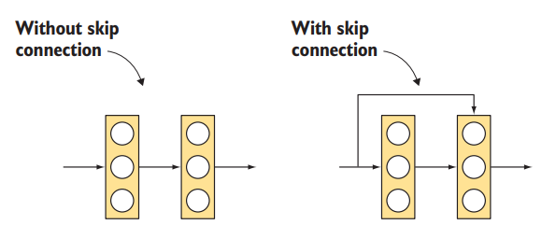
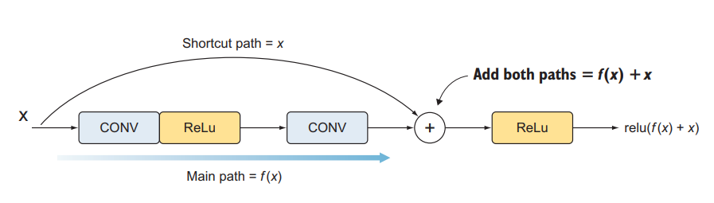
Microsoft’s approach to Vanishing Gradient
To solve the vanishing gradient problem, He et al. created a shortcut that allows the gradient to be directly backpropagated to earlier layers. These shortcuts are called as skip connections.
They are used to flow information from earlier layers in the network to later layers, creating an alternate shortcut path for the gradient to flow through.
Skip connections also allow the model to learn an identity function which ensures that the layer will perform at least as well as the previous layer
ANN’s Case
CNN’s Case

Slide 21
Microsoft’s approach to Vanishing Gradient
Unlike traditionally just stacking the convolutions just one after the other they also add the original input to the output of the stacked convolutional blocks
The shortcut arrow/skip connection is added at the end of the convolution layer
The reason is that we add both paths before we apply the ReLU activation function of this layer
We apply the ReLU activation to f(x) + x to produce the output signal: ReLU(f(x) + x).
Note: This combination of the skip connection and convolutional layers is called a residual block. Similar to the Inception network, ResNet is composed of a series of these residual block building blocks that are stacked on top of each other
CNN’s Case

Slide 22
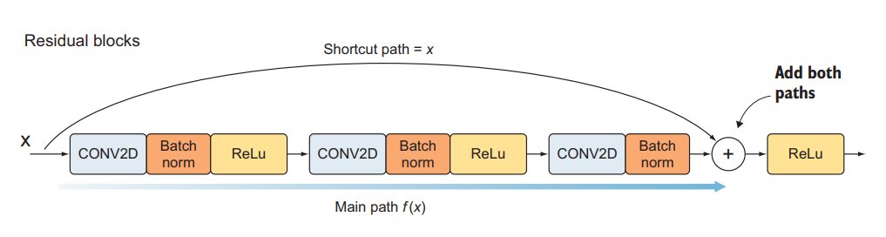
Residual Blocks
Residual blocks consist of two branches
Shortcut path: Connects the input to an addition of the second branch
Main path: A series of convolutions and activations. The main path consists of three convolutional layers with ReLU activations. We also add batch normalization to each convolutional layer to reduce overfitting and speed up training. The main path architecture looks like this: [CONV -> BN -> ReLU] × 3.
As mentioned earlier the shortcut path is added to the main path right before the activation function of the last convolution layer. Then we add ReLU function after adding the two paths.

Slide 23
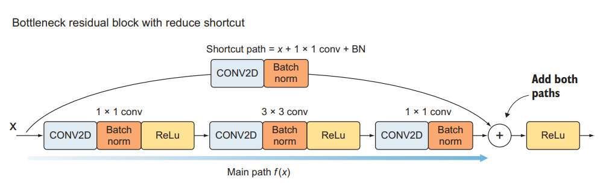
Residual Blocks
He et al. decided to do dimension downsampling using bottleneck 1 × 1 convolutional layers, similar to the Inception network
Residual blocks starts with a 1 × 1 convolutional layer to downsample the input dimension volume, and a 3 × 3 convolutional layer and another 1 × 1 convolutional layer to downsample the output.
This is a good technique to keep control of the volume dimensions across many layers. This configuration is called a bottleneck residual block
Since the volume dimensions are changing due to the bottleneck layers, we also sometimes downsample the shortcut path as well using the bottleneck layer.
Note: ResNets do not have a pooling layer in the network, they instead use strides=2 to downsample the width and height of the image in the reduce layer itself.

Slide 24
ResNet Summary
Residual blocks contain two paths
The shortcut path and the main path.
The main path consists of three convolutional layers, and we add a batch normalization layer to them:
1 × 1 convolutional layer
3 × 3 convolutional layer
1 × 1 convolutional layer
There are two ways to implement the shortcut path:
Regular shortcut: Add the input dimensions to the main path.
Reduce shortcut: Add a convolutional layer in the shortcut path before merging with the main path.

Slide 25
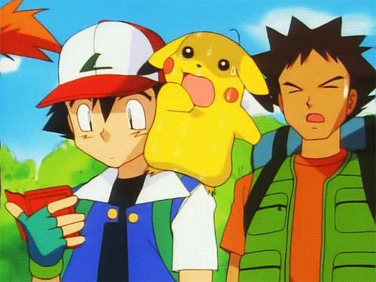
Google’s thoughts on Models running on mobile devices
*Latency*

Slide 26
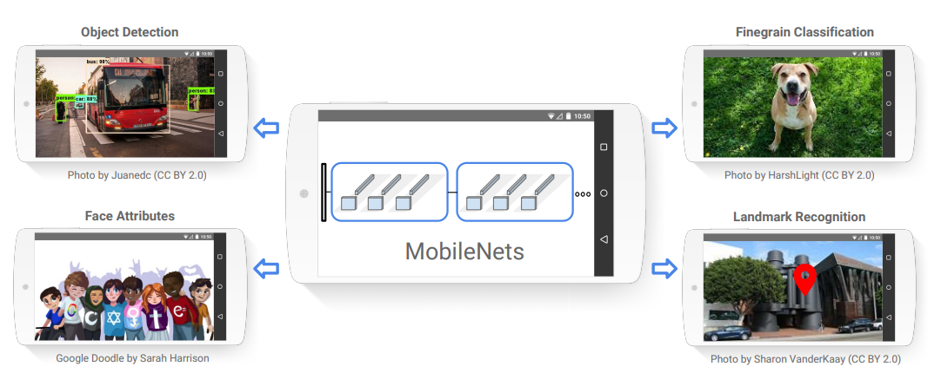
MobileNet: Google’s approach at light weight models
A class of efficient models for mobile and embedded vision applications
Mobilenets make use of Depth Wise Separable Convolutions along with reduce layer (1x1 convolution) to build light weight deep neural networks
Two simple hyperparameters introduced that efficiently trade off between latency and accuracy

Slide 27
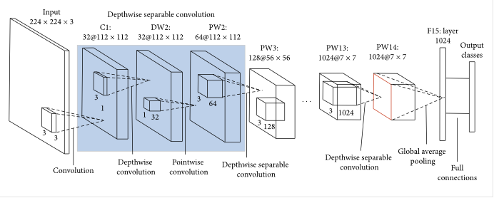
MobileNet

Slide 28
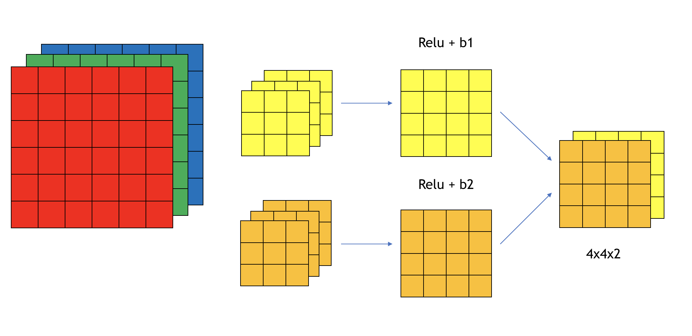
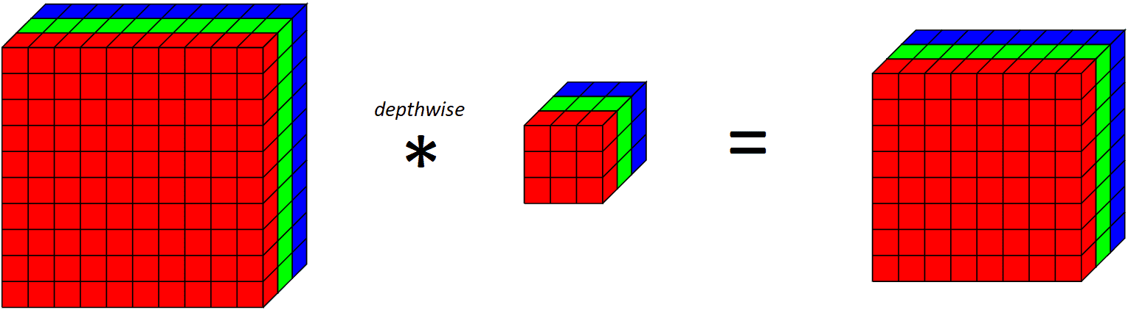
MobileNet Approach: Depthwise Separable Convolutions
In regular convolution a kernel is applied across all channels of the image
A depthwise convolution is basically a convolution along only one spatial channel of the image.
The key difference between a normal convolutional layer and a depthwise convolution is that the depthwise convolution applies the convolution along only one spatial dimension (i.e. channel) while a normal convolution is applied across all spatial dimensions/channels at each step.
Note: Since we are applying one convolutional filter for each output channel, the number of output channels is equal to the number of input channels. After applying this depthwise convolutional layer, we then apply a pointwise convolutional layer. Here the pointwise convolution will not be known as reduce but as expand layer.

Slide 29
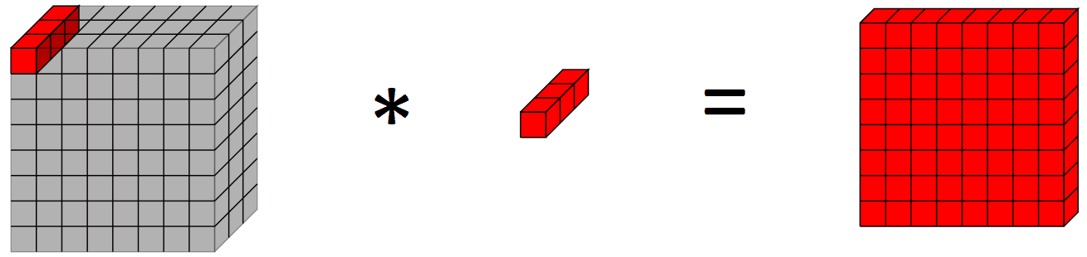
MobileNet Approach: Depthwise Separable Convolution + Pointwise Convolution
Suppose we have a RGB image of size 224x224x3. You want to apply the convolutional layer with 3x3 size kernel with 64 total kernels
3x3x3x64+64=1792 parameters (if directly 64 3x3 kernels are applied)
DSC+ PWC
3x3x1x3+3 = 30 params (DSC)
1x1x3x64+64 = 256 params (PWC)
30 + 256 = 286 parameters
Same operation performed with significantly lesser number of parameters !

Slide 30
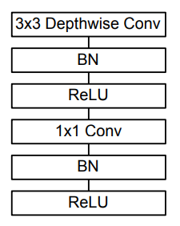
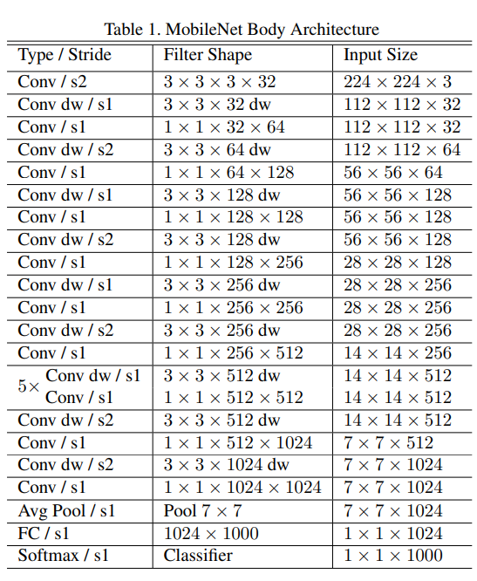
MobileNet Architecture
Note: MobileNet does not use pooling either. It uses strides of 2 for downsampling width and height. This has been the case for most of the modern architectures

Slide 31
MobileNet’s Two Model Lightening Hyperparameters
Width Multiplier: Although the base MobileNet architecture is already small and low latency, many times a specific use case or application may require the model to be smaller and faster.
The role of the width multiplier α is to thin a network uniformly at each layer.
For a given layer and width multiplier α, the number of input channels M becomes αM and the number of output channels N becomes αN. The value of α is typically between [0,1]
Resolution Multiplier: A resolution multiplier ρ is used on the input image and the internal representation of every layer is subsequently reduced by the same multiplier. In practice we implicitly set ρ by setting the input resolution. Value of ρ is typically between [0,1] but as mentioned, in practice the input resolution itself is set typically - 224, 192, 160 or 128

Slide 32
MobileNet Summary
Mobilenet makes use of special type of convolution combined with pointwise convolution
Depthwise Separable Convolutions used along with Pointwise Convolutions to reduce the number of parameters as well as computations
Width Multiplier and Resolution Multiplier hyperparameters used for further making the model more light weight

Slide 33
EfficientNet
To be covered in the next class with Visual Embeddings and Face Recognition

Slide 34
What do CNNs see ?
Class Activation Maps – Naïve and Restricted Approach
Gradient Class Activation Maps (Grad-CAM) – Appropriate for all kinds of tasks
Image Classification
Image Captioning
Visual QnA
Image Segmentation

Slide 35
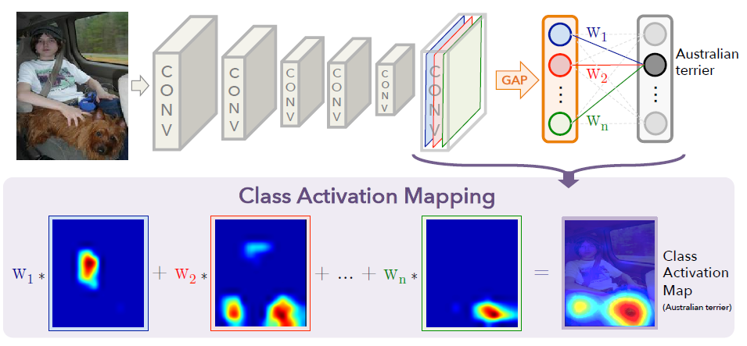
Class Activation Maps
Similar to how you find importance of input features by looking at weights
Weights associated with each Average value of its respective feature map is taken and projected on the image to get its importance
Disadvantage: What if you have fully connected layers instead of directly having a softmax/sigmoid layer after global average pooling

Slide 36
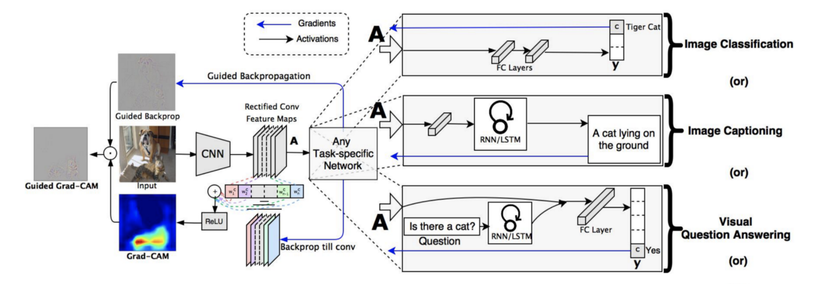
Grad-CAMs

Slide 37
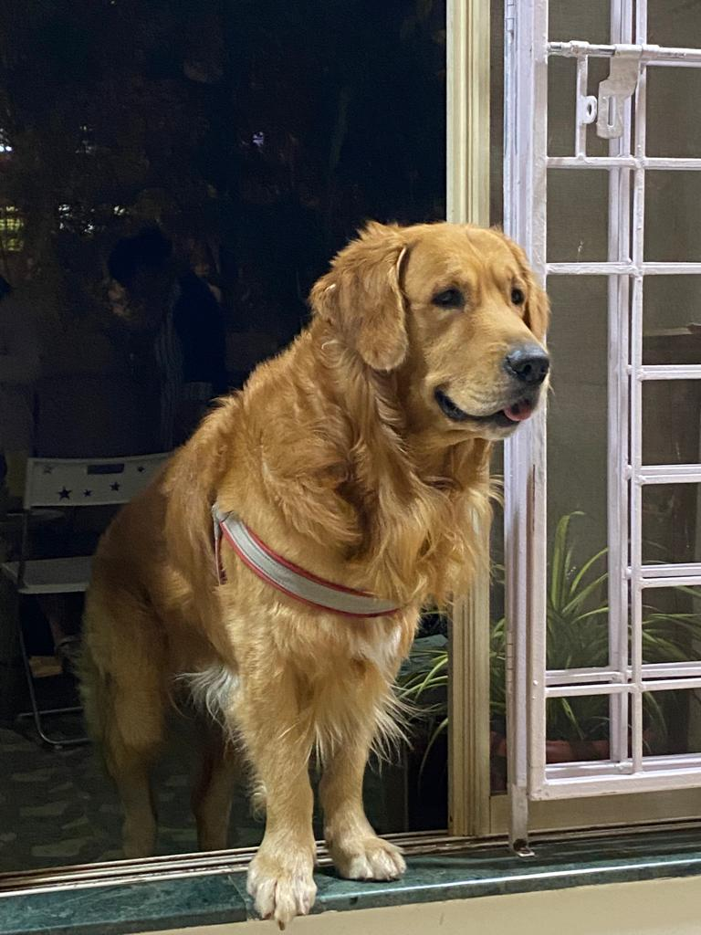
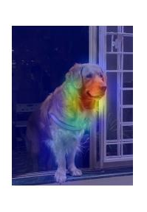
Grad-CAMs: Binary Image Classification
Create a custom model in and deep learning framework tf.keras where
Input: image
Output: Gives last Convolution Output and Classification Probability score
Get the Classification probability score: Sigmoid activation value
Calculate the gradient of this classification activation value wrt to the last Convolution Output
If class probability score/sigmoid activation >= 0.5
Take the average of gradient matrix
Else if its < 0.5 put a negative sign on the gradient matrix and then take its average
Project this averaged gradient on the last convolutional feature map to form a image importance gradient heatmap
We only want the positive impact of this gradient heatmap
Pass the gradient heatmap through a relu function
Normalize the gradient heatmap
Resize the gradient heatmap and project it on to the image

Slide 38
Grad-CAMs: Multiclass Image Classification
Create a custom model in and deep learning framework tf.keras where
Input: image
Output: Gives last Convolution Output and Classification Probability score
Get the Classification probability score: Softmax activation value
Calculate the gradient of this classification activation value wrt to the last Convolution Output
Get the highest voted class probability/softmax activation using max function
Take the average of gradient matrix
Project this averaged gradient on the last convolutional feature map to form a image importance gradient heatmap
We only want the positive impact of this gradient heatmap
Pass the gradient heatmap through a relu function
Normalize the gradient heatmap
Resize the gradient heatmap and project it on to the image

Slide 39
Miscellaneous

Slide 40
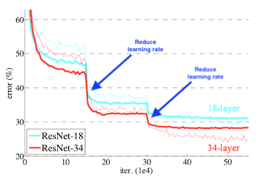
Model Callbacks
EarlyStopping
Checkpointing
ReduceLROnPlateau

Slide 41
ROC and AUC
https://towardsdatascience.com/demystifying-roc-curves-df809474529a
https://towardsdatascience.com/understanding-auc-roc-curve-68b2303cc9c5

Slide 42
Thank you
For any queries drop an email at: quadeershaikh15.8@gmail.com

